Slide 1

Real Time Operating System Squad RTOS

Slide 2
Contents
Project overview.
Real Time Operating System (Squad RTOS).
Squad RTOS communication (TCP/IP)
LWIP library
Web Page
Server (receiving OTP requests and frames) And Security
Desktop application
Squad RTOS project example

Slide 3
Squad RTOS Definition
A Real Time Operating System (RTOS) designed for real time applications.
Used in applications where timing are critical
Examples of such applications include aerospace industrial control system, and medical equipment.

Slide 4
Squad RTOS characteristics
Determinism
Responsiveness
Reliability
Small footprint

Slide 5
Types of Squad RTOS
Hard real-time
Soft real-time

Slide 6

Components Of a Squad RTOS
Kernal
Schedular and dispatcher
Device driver
Application programming interface (API)

Slide 7
Real Time Operating System (Squad RTOS).

Slide 8
WHY USING Squad RTOS ?
Simple applications does not need squad RTSOS only complex applications and many periodic tasks .
Execution threads with different priority levels
Minimizing waiting time
Managing system resources and shared resources

Slide 9
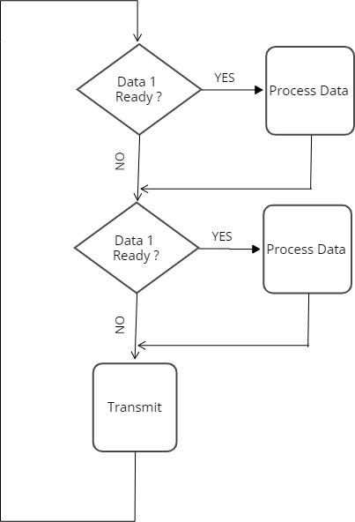
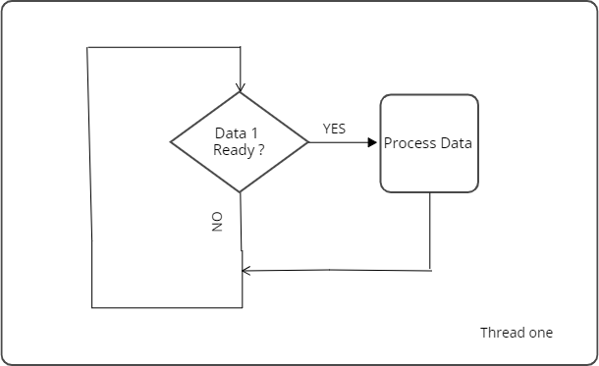
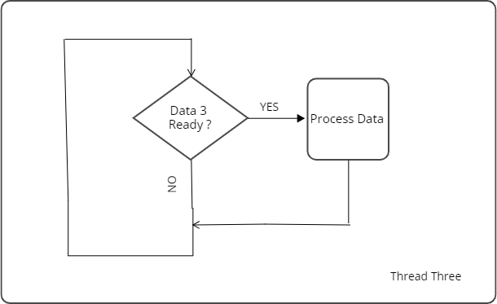

Super loop vs threading
Super loop
OS Threading

Slide 10
Execution thread
A sequence of instruction to be executed.
Has it’s own stack, program counter, flags.
When stopped the thread status is frozen and stored into memory ,and can be restored later
Thread status called context and the memory area called thread control block TCB
Single processor can run single thread in running state , other threads are in waiting state
Unprivileged mode used by threads ,which kernel used privilege mode

Slide 11
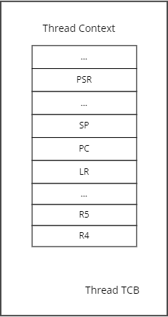
Thread control block

Slide 12
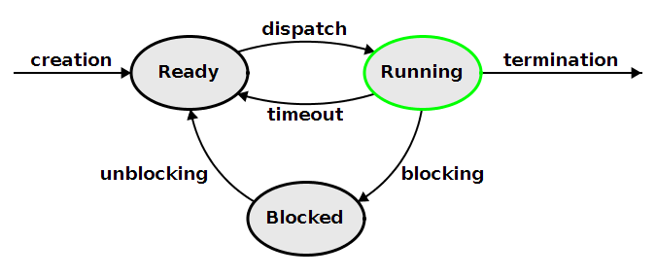
Threads states

Slide 13
Creating thread APIs
Static thread with SquadROTS_SVC_vCreateThread()
Dynamic thread with SquadROTS_SVC_vCreateThreadDynamically ()

Slide 14

Priority based scheduler
Schedular is the part of kernel responsible for determining which thread will run next . Kernel is priority based
Non preemptive vs preemptive
Kernal use round robin scheduling

Slide 15
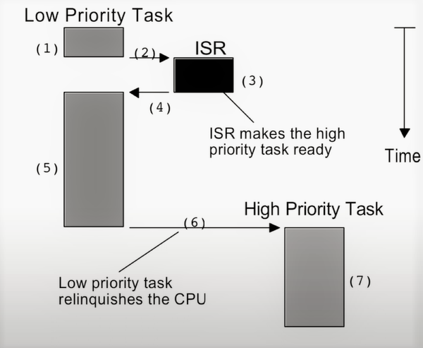
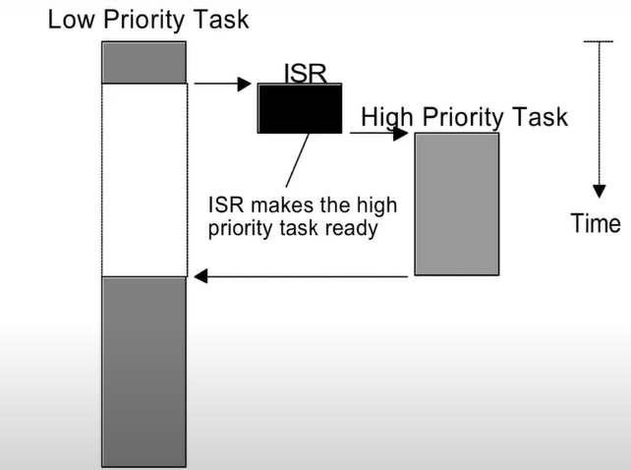
Non preemptive vs preemptive
Non preemptive
Preemptive

Slide 16
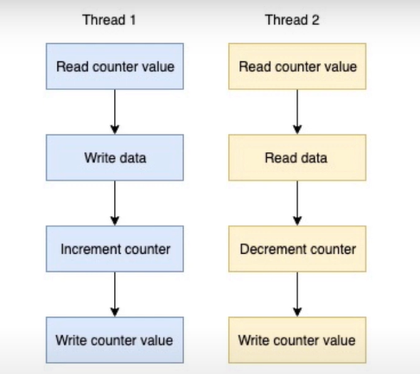
Mutual Exclusion
Two or more threads may want to share the same peripheral or shared memory.
Using atomic operation.
Using critical sections.

Slide 17
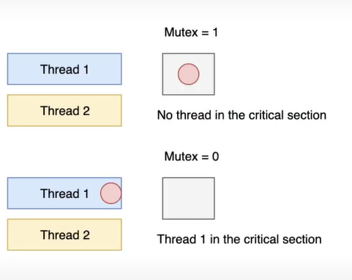
MUTEX
Flag that can be tested and updated automatically .
Mutex have a binary value ( 0, 1 ).
Each thread checks the mutex before entering the critical section.
If it locked thread does not access the shared memory.

Slide 18
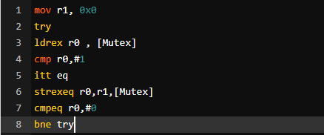
Mutex Implementation
If a thread not able to lock the mutex , Squad RTOS freeze it .
When ever the mutex got released , Squad RTOS wake up the blocked thread .
Mutex lock and release operations are Squad RTOS responsibility .
It implemented using Squad RTOS calls .

Slide 19
Mutex APIs
SquadRTOS_SVC_vCreateMutex(). To create a mutex
SquadRTOS_SVC_vTakeMutex(). To take the mutex
SquadRTOS_SVC_vReleaseMutex() . To release mutex

Slide 20
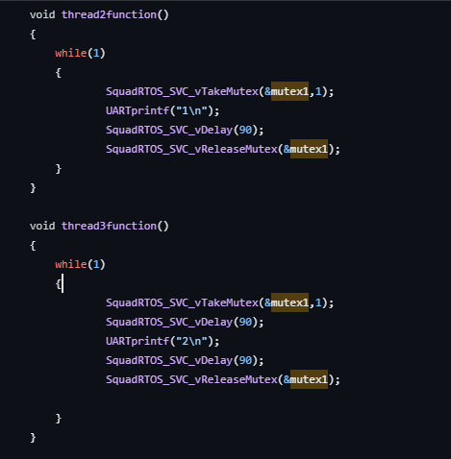
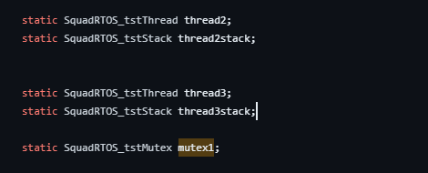
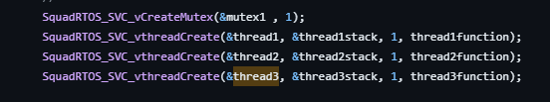
Mutex example in Squad RTOS

Slide 21
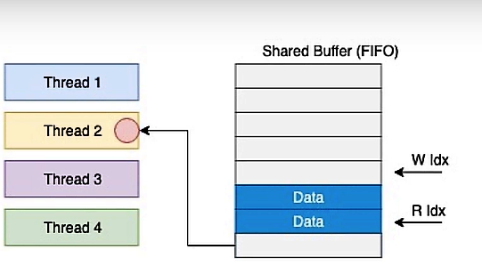
Mailbox
Used for interthread communication .
Using sheared buffer .
Mutex is need for mutual exclusive access.

Slide 22
Mailbox APIs
SquadRTOS_SVC_vMailboxCreate(). To create mailbox
SquadRTOS_SVC_u32MailboxWrite(). To write in mailbox
SquadRTOS_u32MailboxRead(). To read in mailbox

Slide 23
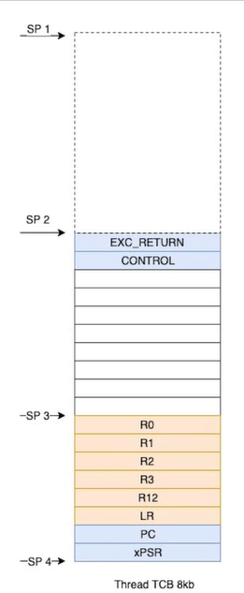
Dispatcher
Definition
Function
Benefits

Slide 24

Delays in Squad RTOS
Thread may wait for response .
Threads may need to stop processing .
Squad RTOS must manage delays.

Slide 25

Delay API
SquadRTOS_SVC_vDelay(90) . To delay task

Slide 26
Periodic tasks
Definition
Implementation
Scheduling.
Benefits

Slide 27
Periodic tasks APIs
SquadRTOS_SVC_vMakeTimer(void** pvTask ,void (*taskCallback)(void*),void * pvArgs) . To make periodic task .
SquadRTOS_SVC_vStart(void* pvHnd) . To start the periodic task. To start a periodic task.
SquadRTOS_SVC_vEnd(void* pvHnd). To stop the periodic task.
SquadRTOS_ChangePeriod(void* pvHnd,uint32_t u32Second). To change periodicity of the periodic task.
SquadRTOS_SVC_vDeleteTimer(void** ppHnd). To delete the periodic task .

Slide 28


Memory management in Squad RTOS
Dynamic allocating Ballooning Swapping

Slide 29
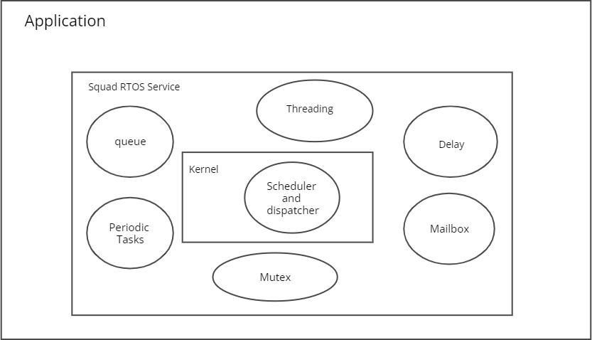
Squad RTOS diagram

Slide 30
Squad RTOS communication (TCP/IP)

Slide 31

WHY USE TCP/IP?
So the microcontroller wont be embedded in its own place only and will be able to communicate with outside devices.
This allows the use of public IPs and for anyone to be able to access it from anywhere.
It also opens access to IOT(Internet Of Things) so users will be able to make applications using IOT.

Slide 32
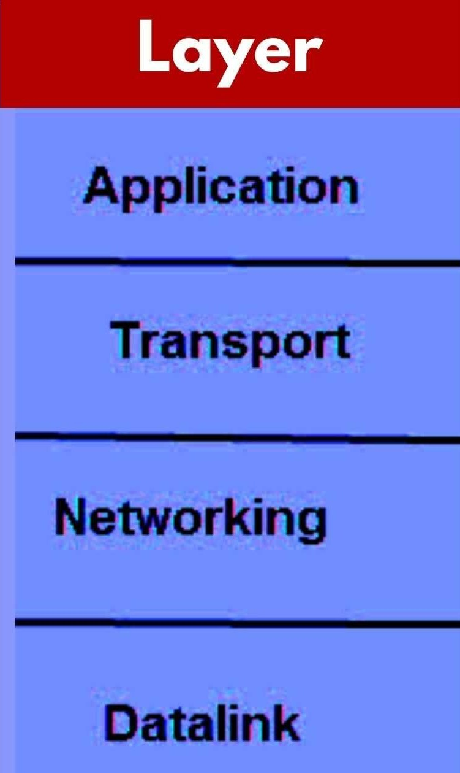
TCP/IP Layers:

Slide 33

Data Link Layer:
In this layer we used the ethernet protocol to be able to transmit data over a LAN.

Slide 34

Network Layer:
This layer is responsible for providing logical addressing and routing services to enable communication between different networks.
In this layer we used the IP protocol.

Slide 35

Transport Layer:
It provides essential services for ensuring reliable and efficient communication between applications running on different devices on a network.

Slide 36
Application Layer:
The Application Layer in TCP provides essential services for enabling applications to communicate with each other over a network.
In this layer we use the HTTPs protocol.

Slide 37
LWIP
What is lwIP?
lwIP (lightweight IP) is a widely used open-source TCP/IP stack designed for embedded systems.
Was developed by Adam Dunkels at the Swedish Institute of Computer Science.
Why do you need TCP/IP stack ?
To perform a standard communication over the internet.
Why lwIP?
It can easily run on smaller embedded system.
Characteristics
Open source
Portable
High performance
Dependable communication
Features and protocols
IP
IGMP
ICMP
DHCP

Slide 38
LWIP
Why do you need TCP/IP stack ?
To perform a standard communication over the internet.
Why lwIP?
It can easily run on smaller embedded system.
Characteristics
Open source
Portable
High performance
Dependable communication
Features and protocols
IP
IGMP
ICMP
DHCP
MSISDN
A maximum 15 digits used to reach another GSM subscriber
Consists of: -
Country code (CC)
National destination code (NDC)
Subscriber number( SN)
EXAMPLE: -
CC NDC SN
100 8030808
***STORED IN HLR***

Slide 39
MSISDN
A maximum 15 digits used to reach another GSM subscriber
Consists of: -
Country code (CC)
National destination code (NDC)
Subscriber number( SN)
EXAMPLE: -
CC NDC SN
100 8030808
***STORED IN HLR***
IMSI
A unique primary identity of subscriber and is permanently assigned to him
Consists of: -
Mobile country code (MCC)
Mobile network code (MNC)
Mobile station identification number (MSIN)
EXAMPLE: -
MCC MNC MSIN
602 02 1234567890
***SRORED IN HLR***
Characteristics
Open source
Portable
High performance
Dependable communication
Features and protocols
IP
IGMP
ICMP
DHCP
LWIP

Slide 40
MSISDN
A maximum 15 digits used to reach another GSM subscriber
Consists of: -
Country code (CC)
National destination code (NDC)
Subscriber number( SN)
EXAMPLE: -
CC NDC SN
100 8030808
***STORED IN HLR***
IMSI
A unique primary identity of subscriber and is permanently assigned to him
Consists of: -
Mobile country code (MCC)
Mobile network code (MNC)
Mobile station identification number (MSIN)
EXAMPLE: -
MCC MNC MSIN
602 02 1234567890
***SRORED IN HLR***
TMSI
A secure temporary identity used subsequently for identification
In case of backet switching we use PACKET TMSI instead
As these methods keep the subscriber safe from being identified by some one trying to monitor the radio channel
***STORED IN VLR***
Features and protocols
IP
IGMP
ICMP
DHCP
LWIP

Slide 41

Set up the microcontroller to communicate over Ethernet using lwIP networking stack
Read MAC address from non-volatile memory.
Initialize lwIP with DHCP.
Initialize a sample http server and CGI handlers.

Slide 42
Web Page

Slide 43
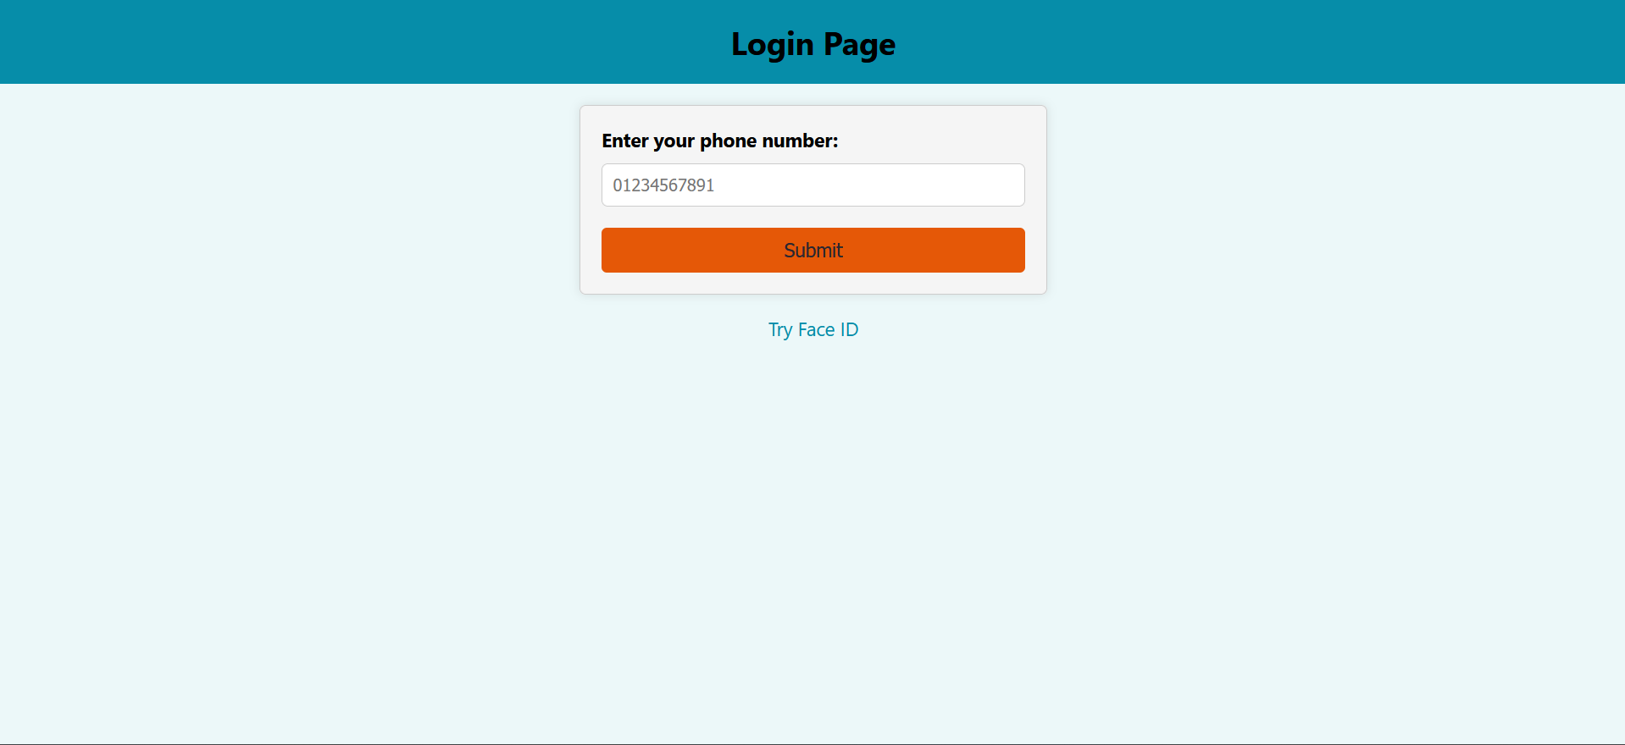
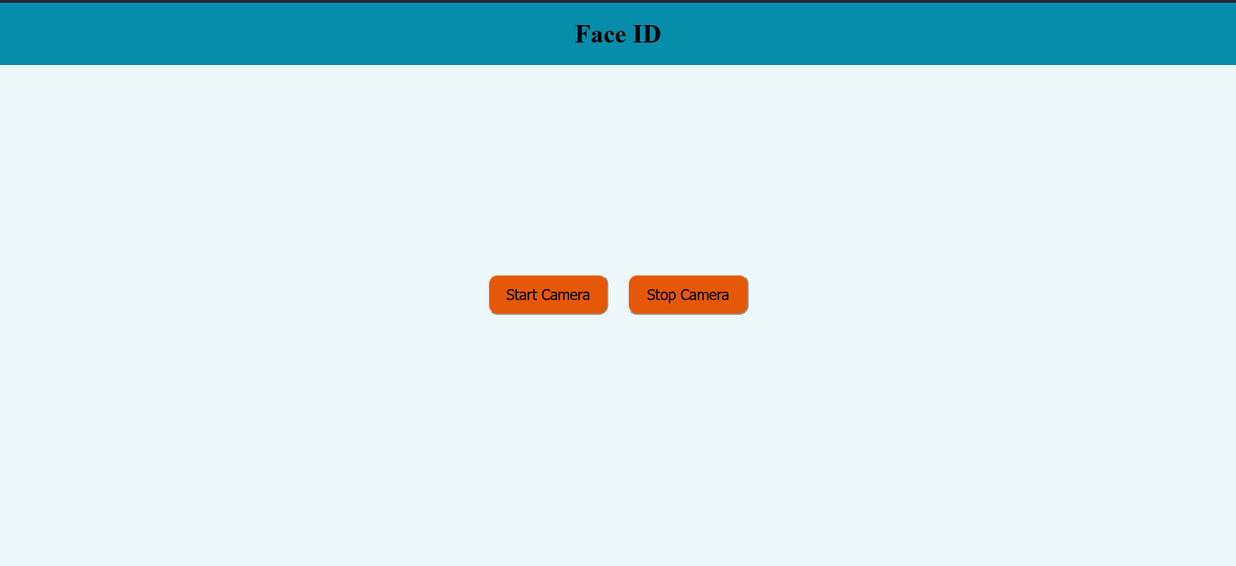
Login Page

Slide 44
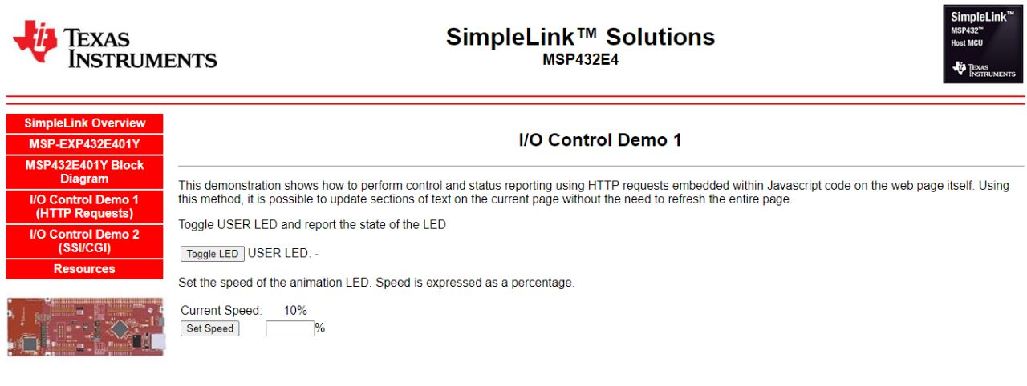
Services Page

Slide 45
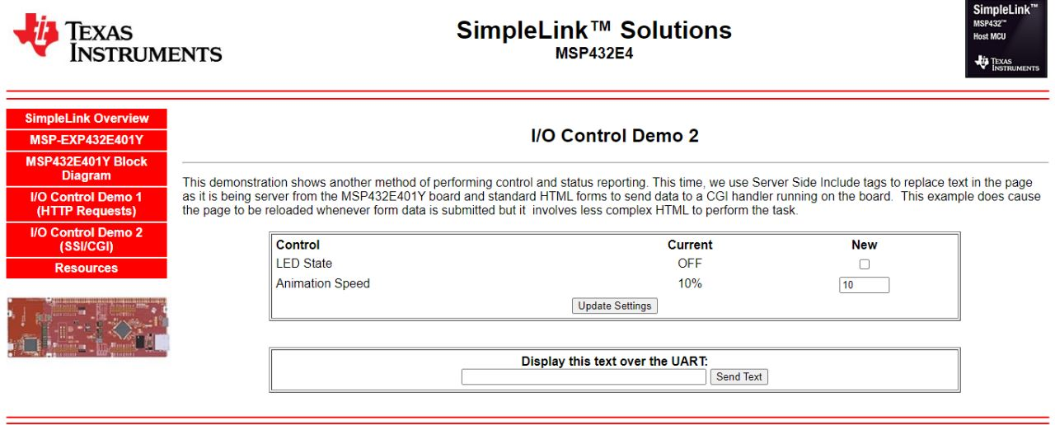

Slide 46
Verification
main sign in page
sign up page
error message
As the user opens our application , First he needs to sign in or sign up into the application to obtain a very important security feature ,which is keeping every specific task , operation or even information secret between only the user and the Operating system, which means that every user can access the operating system anytime and use it simultaneously but also safely without any interruption between multiple users.

Slide 47
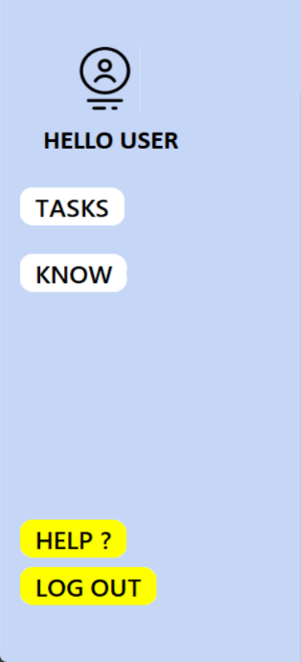
Left panel
TASKS button: which declares the tasks that are currently being worked on. KNOW button: in case of new user this button will open a window that contains all the information about the tasks we have. HELP button: which will provide all communication information of the programmer in case there is a problem hard to solve with the user. LOGOUT button : like the name says it's used to close the account to exit the program or switch accounts

Slide 48
Second Frame
- A text widget is used to save the notes the user takes in a word file out of the program using a combination of get and create functions. - A clock of real time that we used some functions from time library we talked about before to implement and show as it upgrades its value every 1 second.

Slide 49
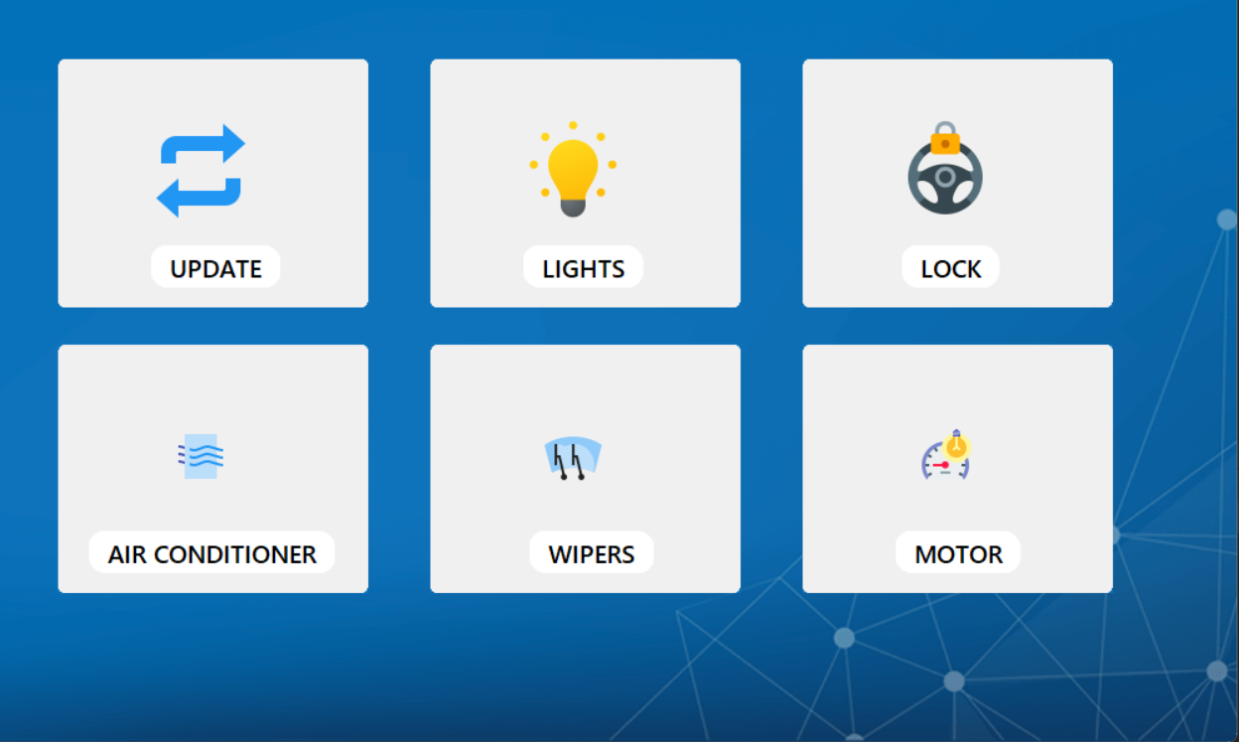
Main Page
Finally, the main frame includes the tools of the user or in other words they are the tasks that our program provides, and it can vary from one usage to another depending on the goal that the user wants to reach.

Slide 50
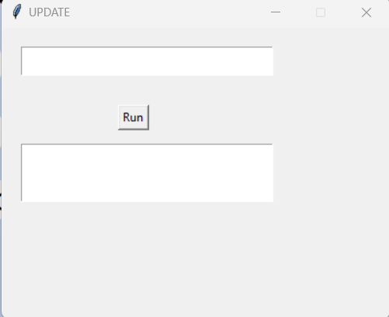
CMD update
a very helpful task that cooperates with the HELP button we talked about before as after you
communicate with the programmer you may need to write code on the CMD window and using this update widget you shall pen a text widget that can be considered a CMD and will send all the commands that the user types to the OS.

Slide 51
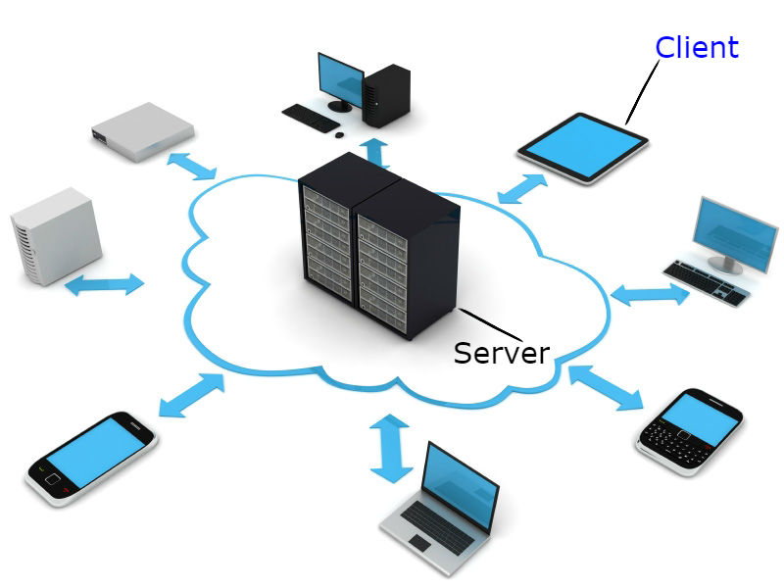
Servers are designed to handle and manage requests from multiple clients simultaneously
the HTTP server created by the Python script is a program that listens for incoming requests over the network and provides responses to clients. It acts as a server in the client-server architecture, where clients send requests to the server and receive responses in return.

Slide 52

Application Programming Interface.
An API is a set of protocols, routines, and tools for building software applications.
Make a request to the API endpoint using the appropriate HTTP method (e.g., GET, POST, PUT, DELETE) and passing any necessary data or parameters.

Slide 53












confidentiality
AI
Face recognition
integrity
availability
frames
CHAPTER 5
In this chapter we were mainly concerned with giving the user the most amount of security we can provide.

Slide 54

SECURITY
CONFIDENTIALITY: -
The first step we took to implement confidentiality is that we used a server that generates a token that consists of 128 bit of digits that changes every time our user needs to access the services that we provide and not only this we also use face recognition to make sure of the permissions of this user.

Slide 55

AI: -
AI has made significant advancements in face recognition technology, making it more accurate, efficient, and accessible for a wide range of applications.

Slide 56

Face recognition: -
ace recognition is one of the main branches of deep learning that we can deal with and to implement face recognition in our project, we used a library that python provides called Face_recognition

Slide 57

Frames: -
We had some problems in sending the captured video to the server so that we can test it and find if it has permissions or not

Slide 58

SECURITY
Integrity: -
Integrity can't be a problem for us as we don't provide a data base that can be infected by any attacker also our code is open source so it can be modified by any one.

Slide 59

SECURITY
Availability: -
we made sure that there's a time out period for each user as if they left the system with no orders, it would automatically clear the place it occupies for other users to prevent any unwanted traffic.

Slide 60

The Home Application

Slide 61

Components
IR sensor
LCD
relay sensor
Buzzer
Arduino

Slide 62

the main task
Fire detection

Slide 63
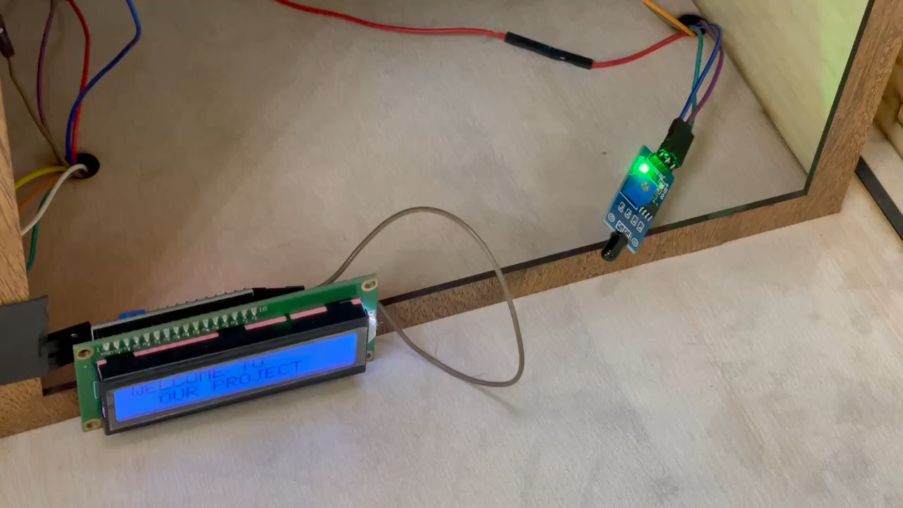
Step 1:

Slide 64
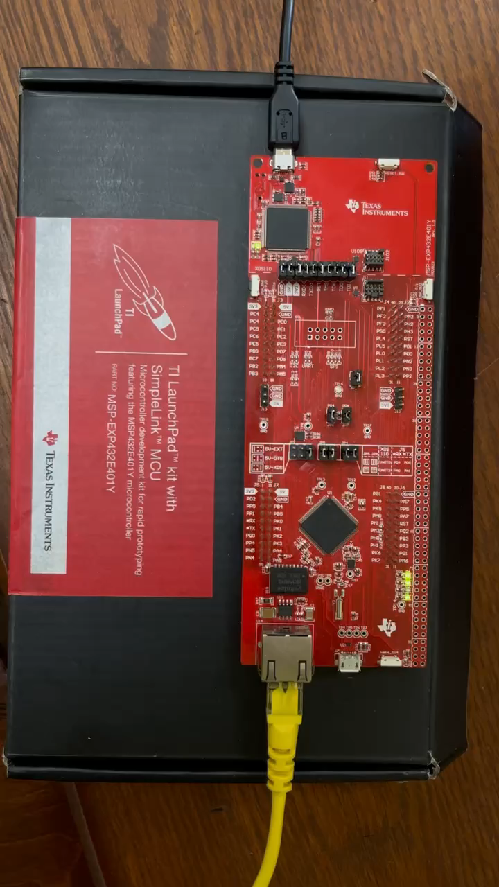
Step 2:

Slide 65
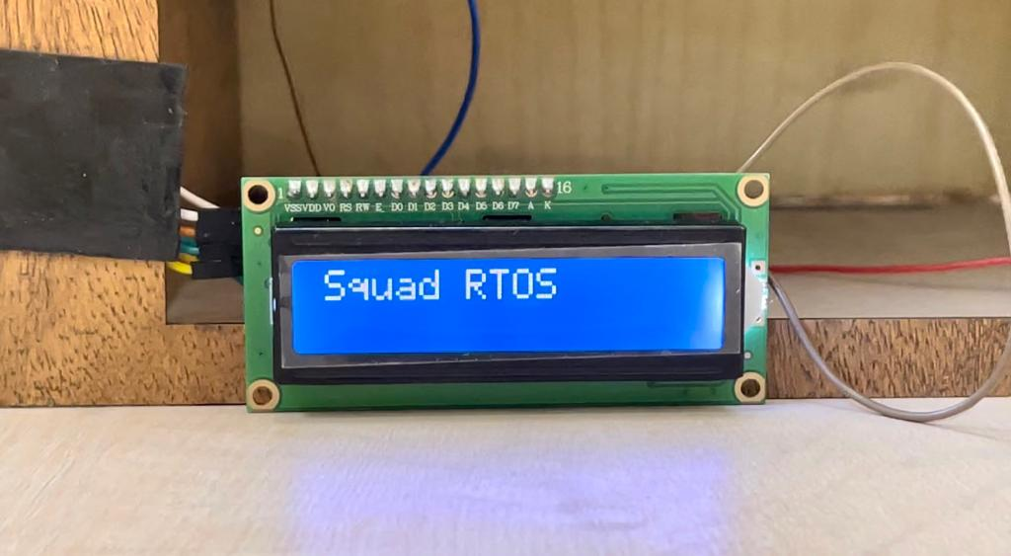
Step 3:

Slide 66

Thank you

